Slide 1
Successful CW
Making and Confirming QSO’s in Morse Code

Slide 2
Are you ready for CW?
Group sessions will start at the end of October.
Helping each other get on the air.

Slide 3
Prerequisite for Success
Turn on your ‘Want to’s’
Be ready to get on the air.
  There is no magic pill for CW.
  You will need a operating station
Create an ARRL LoTW account
  Be rewarded with confirmed contacts.

Slide 4
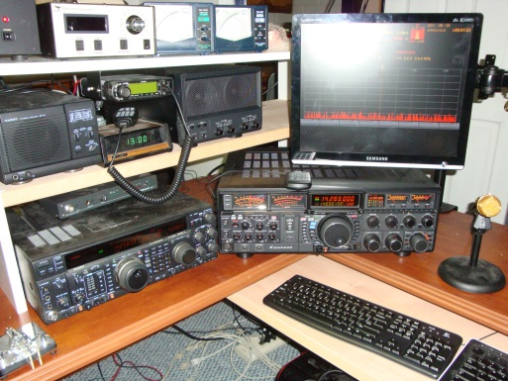
How to get on the air with CW
Set up your station
Learning a few basics about operation
  The radio
  The computer
  The interface
  The software
Learn CW words and techniques
Setup a logbook with LoTW.

Slide 5
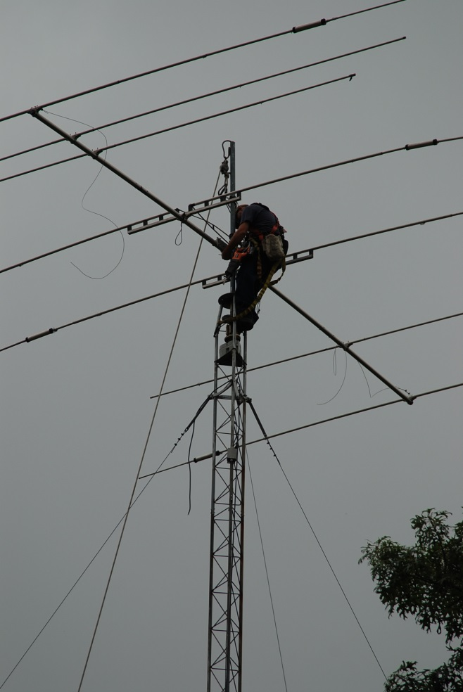
Station Set-up
An HF Antenna
A computer controlled Radio
An Interface
A computer
Software
Lastly, a key or keyer

Slide 6
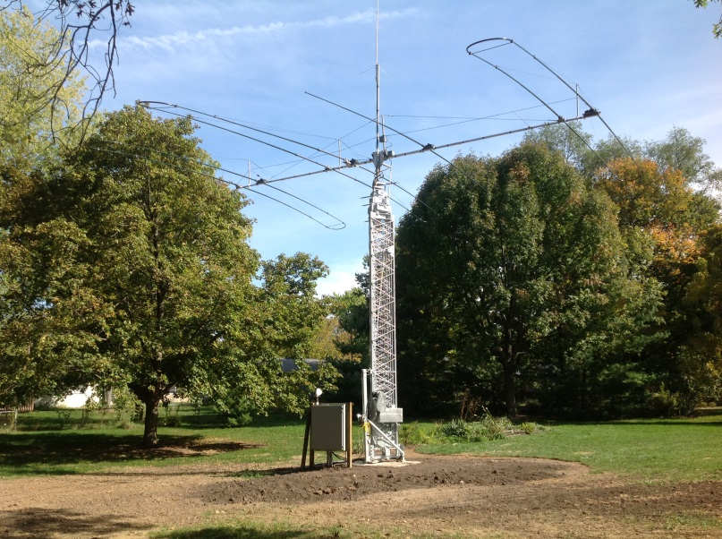
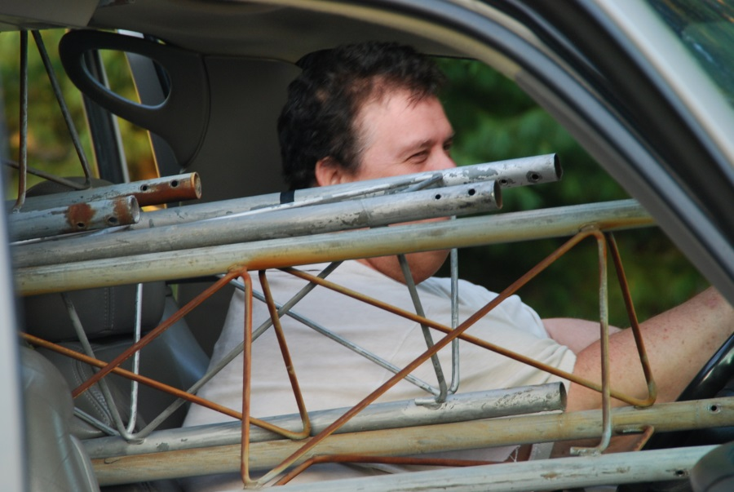
The Antenna
Any antenna can be used to work CW.
A dipole, a vertical or a Yagi.
You can always upgrade later.

Slide 7
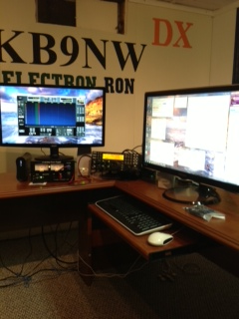
Finding the Right Radio
No gimmicks here:
Your choice of various manufacturers.
The radio should be capable of accepting a radio interface.

Slide 8
The Interface
Several companies provide these radio interface products.
West Mountain Radio has the RigBlaster.
The MicroKeyer is the top of the line.
The WinKeyer is basic and is an excellent device.
The interface has a port for your key (If you must use one)

Slide 9
A dedicated computer
Purchase a computer for your station.
Connect the cables and leave them alone.
Once the system works, you will not want to disconnect any cables.
Label the cables and where they connect.
Get your computer connected to the Internet. Use DxSpotting (www.dxfor.me)

Slide 10
Which software to use?
Several groups have software for free or for sale at a minimum price.
Pick ONE and learn it.
My preference is N1MM but HRD is very popular.
The software will allow you to program short exchanges.

Slide 11
Pimslear says CW is easy!
Learn the first 10 most popular words.
  CQ – Tune the radio when you hear this.
  DE – The next word is the stations call sign.
  599 – your received and sent signal report.
  TU – Thank-You
  NR – I Need your Report
  73 – Goodbye
  QRZ – your opportunity to transmit
  AGN – Please repeat
  ? – di di dumb dumb di dit
  / - The station is operating remote
Then: K, R, QSL, SRI, NIL, IL (etc)
Contest & DX specfics

Slide 12
Suzuki says to Get Operational
Making the first contact.
Do you ‘Search and Pounce’ or call CQ?
Use the software tools:
  Write Macros.
  Look at the Internet bandmap.
  CW Skimmer for working splits.
Learn the rhythm of the other signal.

Slide 13
What to expect
Document your station equipment.
Try to bring a laptop to class
Be ready to learn and practice.
  This class is your opportunity to operate.
  You need the right equipment.
  It’s a joint effort between us.
We will listen to real on air audio.
Software will be explained.
CW Macros defined

Slide 14
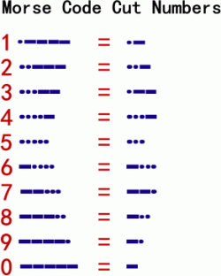
CW Shortcuts
What are cut numbers? 5nn, ate,
Setting up your radio.
Tuning your radio to the right frequency.
Operating Split Frequency.
Contest and DX Shorthand

